Slide 1
Slide Master

Slide 2
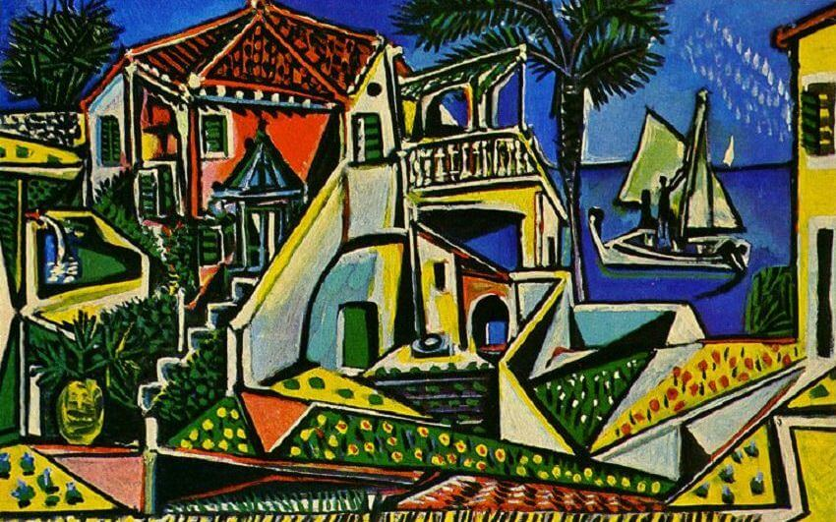
Mediterranean Landscape
Pablo Picasso

